Slide 1
On the Sybil-Proofness of Accounting Mechanisms in P2P Networks
Alexander Stannat
Master Thesis Defence
Applied Mathematics

Slide 2
The Evolution of Social Cooperation
What is the reason humans dominate the evolutionary game?
Cooperation!
Language Gossip
Human interactions are instances of game theory.
Evolution engenders competition.
Tragedy of the commons

Slide 3
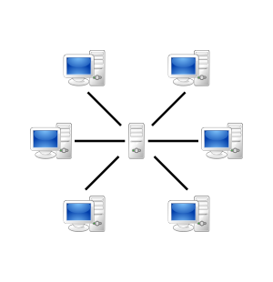
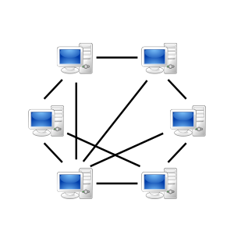
Cooperation in P2P File Sharing Networks

Slide 4
Problem
It is beneficial to consume data, but not to contribute to others
Tragedy of the commons
Some agents may decide to only consume data (lazy freeriding)
How can we incentivise cooperation?
Reciprocity! Collaborators need to be rewarded

Slide 5
5 Mechanisms to enforce Cooperation
Kin Selection:
Direct Reciprocity: A node cooperates so long as its partner node cooperates, else it defects.
Indirect Reciprocity: Reputation fuels cooperation.
Network Reciprocity:
Group Selection:

Slide 6

BitTorrent & Direct Reciprocity
BitTorrent uses a mechanism of direct reciprocity: Tit-for-Tat
A seeding peer (A) chooses 5 downloaders
4 with the highest upload rates to A
1 randomly chosen (optimistic unchoking)
If node B doesn‘t contribute to A, A „chokes“ out B
Node B can then only hope to be optimistically unchoked again (low probability, download much slower)

Slide 7
Problem with Direct Reciprocity
Interactions are often asymmetric and fleeting
Direct Reciprocity: Tit-for-tat
Relies on repeated encounters between the same people
Prisoner’s Dilemma
Defecting more beneficial than cooperation when swarms become too big
We need to expand our mechanism beyond bilateral relationships.
Indirect Reciprocity

Slide 8
Tribler and Indirect Reciprocity
Tribler aims to incorporate a mechanism of indirect reciprocity to enforce cooperation.
Reputation Mechanism
Nodes contribute to higher ranking nodes more often than nodes with a lower reputation.
Goal: An algorithm, ranking agents based on their history of cooperation in the network
TrustChain Data Structure

Slide 9
Cooperation through Accounting Mechanisms
[1]
Lazy Freeriding
Misreports
Sybil Attacks
Research Question:
What requirements does an accounting mechanism need to satisfy in order to effectively incentivise cooperation and prevent lazy freeriding, while being resistant to misreport attacks and mitigating the effects of sybil attacks?
Seuken, Sven, Jie Tang, and David C. Parkes. "Accounting mechanisms for distributed work systems." Twenty-Fourth AAAI Conference on Artificial Intelligence. 2010.

Slide 10
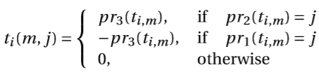

Mathematical Framework
Agent Transaction: $(i,j,w)$
Transaction Sequences: $TS_{i}≔{\left(t_{i,n}\right)}_{n∈ℕ_{≤T_{i}} }$
Transaction Functions: $t_{i}:$ $ℕ_{≤T_{i}}×V→ℝ$
Transaction Sets: $TS≔\left\{TS_{i} \right| i∈V\}$
Notes:
Agent Transaction: Giving agent always first, receiving second, w>0 always
Transaction Sequence: t_i,n is the n-th transaction that i was involved in, T_i is the length of the transaction sequence
Assume transactions can be deterministically serialised

Slide 11
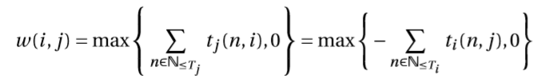
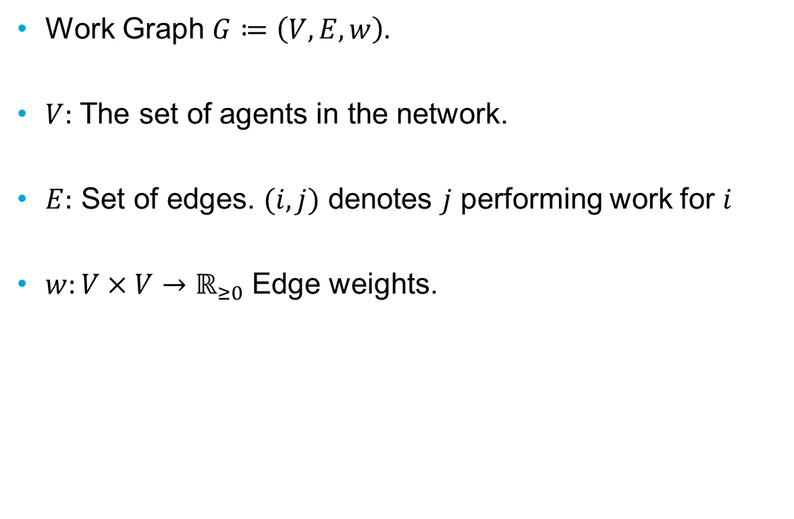
Work Graph
Work Graph $G≔\left(V,E,w\right).$
$V:$ The set of agents in the network.
$E:$ Set of edges. $(i,j)$ denotes $j$ performing work for $i$
$w:V×V→ℝ_{≥0}$ Edge weights.

Slide 12
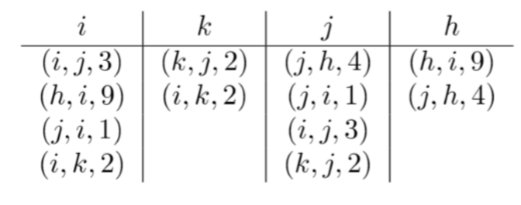
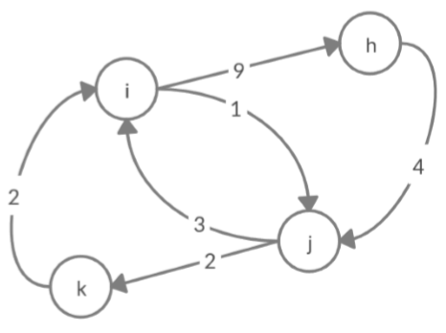
Example Work Graph

Slide 13
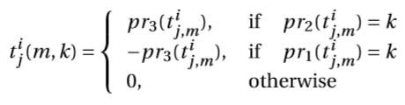
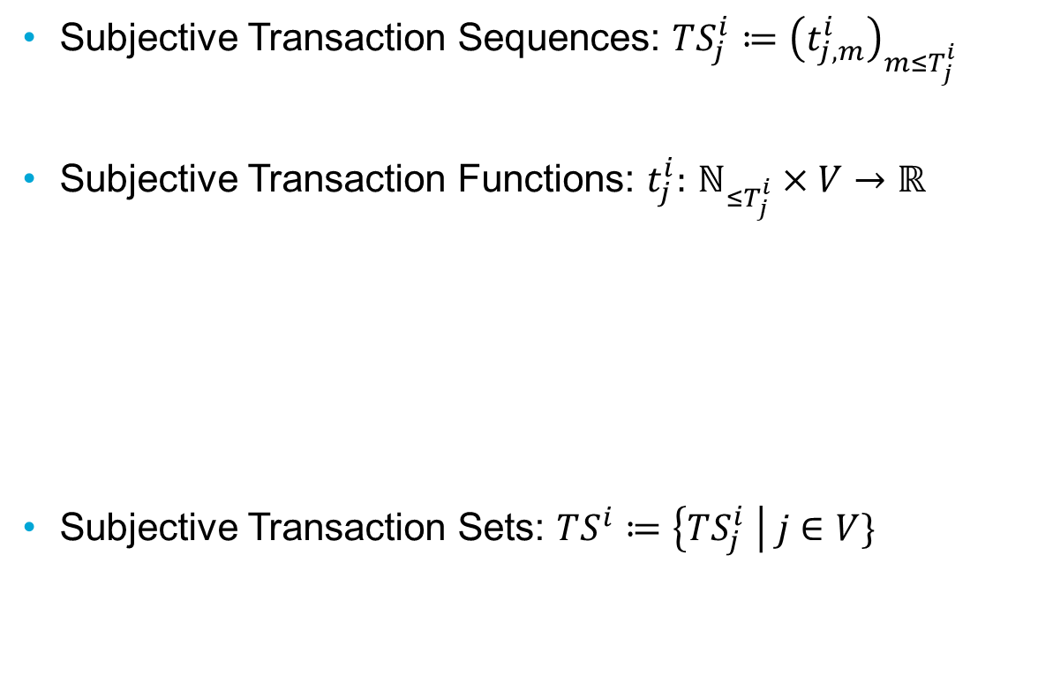
Agent Information & Subjective Work Graphs
Subjective Transaction Sequences: $TS_{j}^{i}≔{\left(t_{j,m}^{i}\right)}_{m≤T_{j}^{i} }$
Subjective Transaction Functions: $t_{j}^{i}:$ $ℕ_{≤T_{j}^{i}}×V→ℝ$
Subjective Transaction Sets: $TS^{i}≔\left\{TS_{j}^{i} \right| j∈V\}$

Slide 14
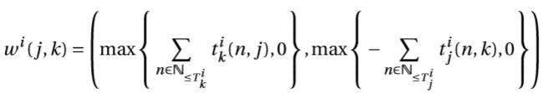

Subjective Work Graph
Subjective Work Graph $G_{i}≔\left(V_{i},E_{i},w_{i}\right).$
$V_{i}⊂V$
$E_{i}⊂V_{i}×V_{i}$
$w^{i}:V_{i}×V_{i}→ℝ_{≥0}×ℝ_{≥0}$

Slide 15
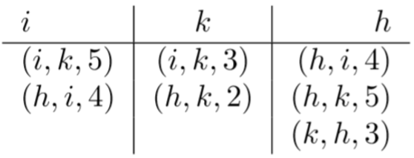
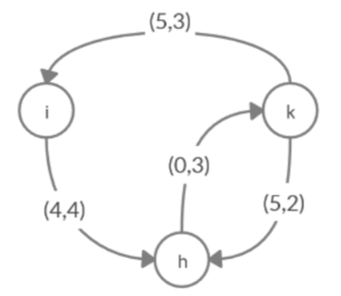
Example Subjective Work Graph

Slide 16





Accounting Mechanisms & Allocation Policies
Choice Set:

Slide 17
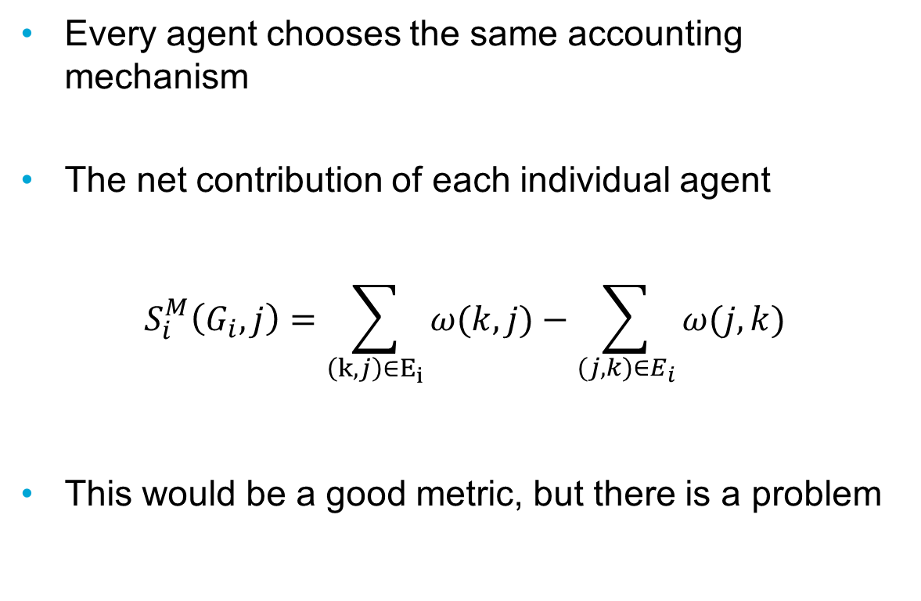
A trivial approach
Every agent chooses the same accounting mechanism
The net contribution of each individual agent
$$S_{i}^{M}\left(G_{i},j\right)=\sum_{\begin{aligned}\left(k,j\right)∈E_{i} \\ \end{aligned}}{ω(k,j)}−\sum_{(j,k)∈E_{i}}{ω(j,k)}$$
This would be a good metric, but there is a problem

Slide 18
Sybil Attacks
A user can create large numbers of fake accounts
Sybil nodes can create fake edges between one another
Reported edge weights can no longer be trusted, except for those connected to the seed node itself
The trivial accounting mechanism is no longer valid
The goal is to game the accounting mechanism and obtain larger accounting values such that larger amounts of work can be consumed.

Slide 19
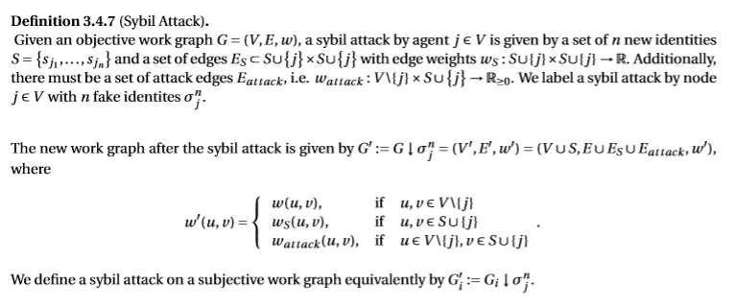
Sybil Attacks

Slide 20
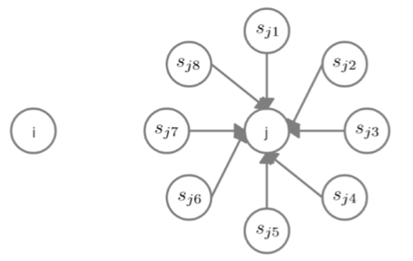
Example Sybil Attack

Slide 21
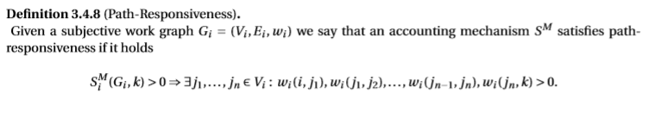
Provisional Solution
Attack Edges are required for a Sybil attack to be successful.

Slide 22
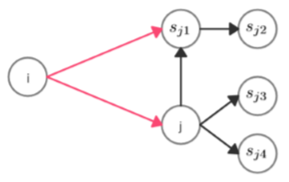
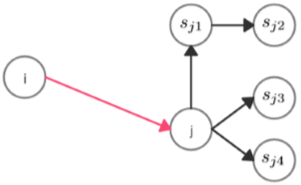
Active vs. Passive Attacks
Passive
Active

Slide 23
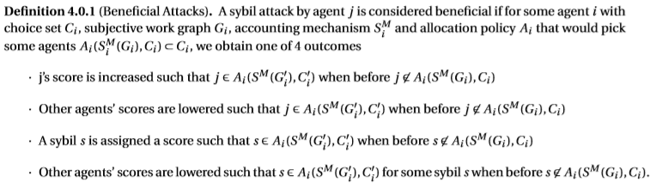
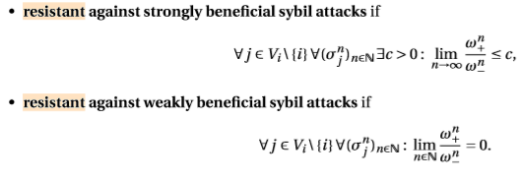

Mathematical Framework for Sybil Attack Gain
Definition of Sybil Attack Gain
Problem: Not rigorous enough
[2]
2. Seuken, Sven, and David C. Parkes. "On the Sybil-proofness of accounting mechanisms." (2011).

Slide 24

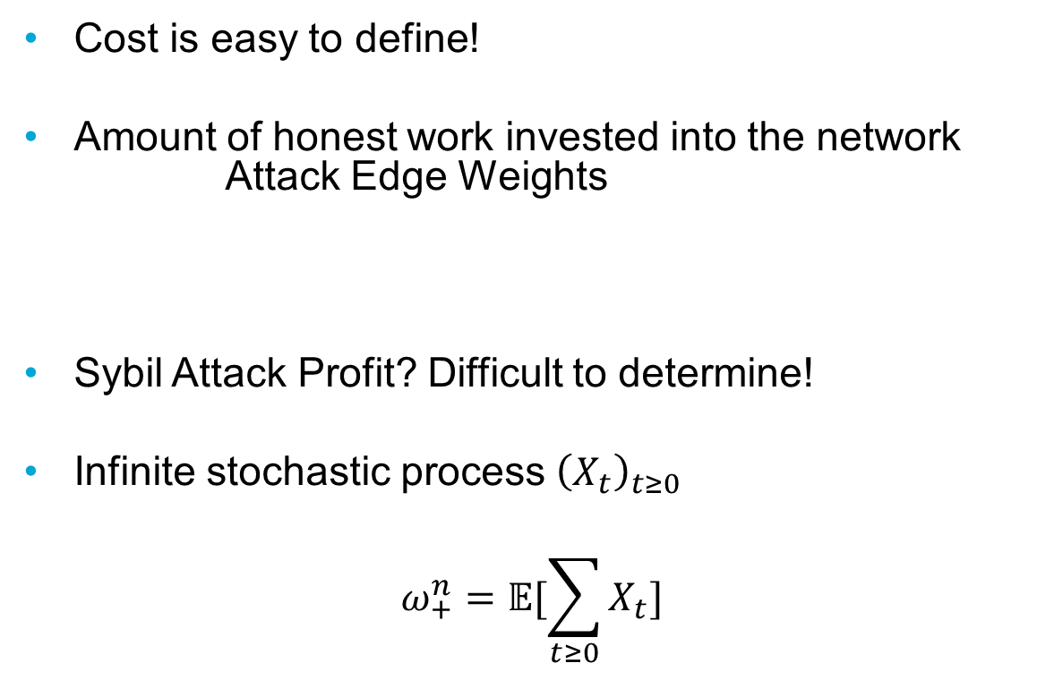
Sybil Attack Cost & Profit
Cost is easy to define!
Amount of honest work invested into the network Attack Edge Weights
Sybil Attack Profit? Difficult to determine!
Infinite stochastic process ${\left(X_{t}\right)}_{t≥0}$
$$ω_{+}^{n}=𝔼[\sum_{t≥0}{X_{t}}]$$

Slide 25

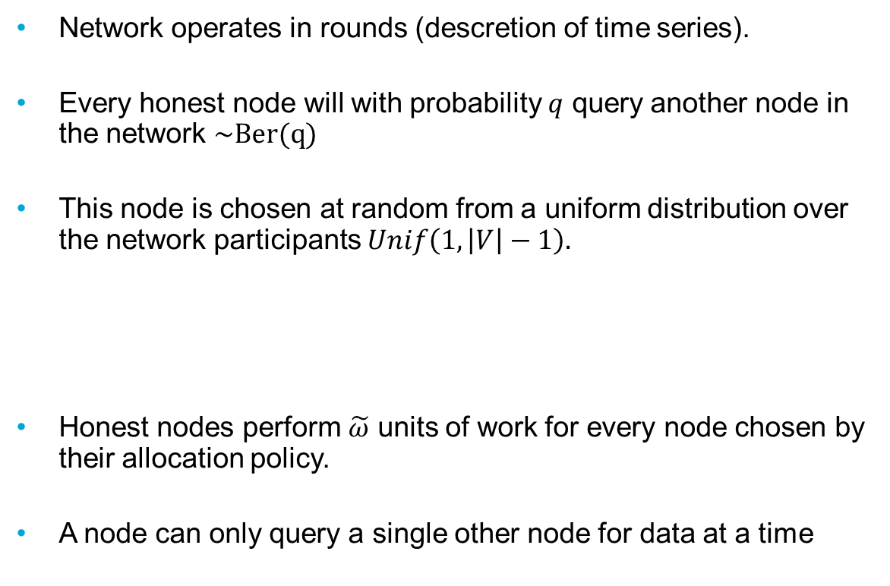
Interaction Model
Network operates in rounds (descretion of time series).
Every honest node will with probability $q$ query another node in the network $\sim Ber(q)$
This node is chosen at random from a uniform distribution over the network participants $Unif\left(1,\left|V\right|−1\right).$
Honest nodes perform $\tilde{ω}$ units of work for every node chosen by their allocation policy.
A node can only query a single other node for data at a time

Slide 26
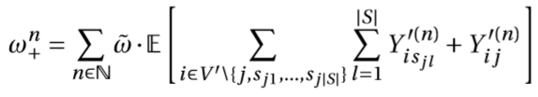

Sybil Attack Profit
${\left({G_{i}^{′}}^{\left(n\right)}\right)}_{n∈ℕ}$
${Y_{ij}^{′}}^{(n)}≔𝟙_{\{j∈A_{i}(S_{i}^{M}\left({G^{′}}_{i}^{\left(n\right)}\right),{C_{i}^{′}}^{(n)})\}}$
Notes:
At this point we must assume an infinite model for the upper value to be finite in the case of a simple node creation

Slide 27


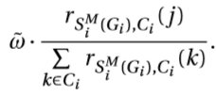

Choosing an Allocation Policy
Top n policy:
Winner takes all:
Rank-weighted Distribution Policy:

Slide 28
Choosing an Allocation Policy
Assume all agents share the same allocation policy.
Compare winner takes all, top-n and distribution policies.
Winner-takes-all policy is most resistant to large scale sybil attacks.
Winner-takes-all policy effectively prevents lazy freeriding.

Slide 29
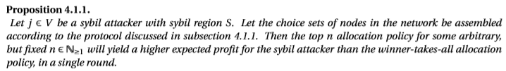

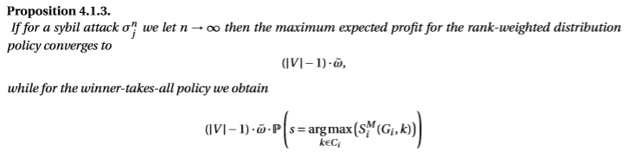
Propositions and Theorems

Slide 30



Largest Expected Profit of a Sybil Attack
Winner takes all:
Top n policy:
Distribution policy:

Slide 31
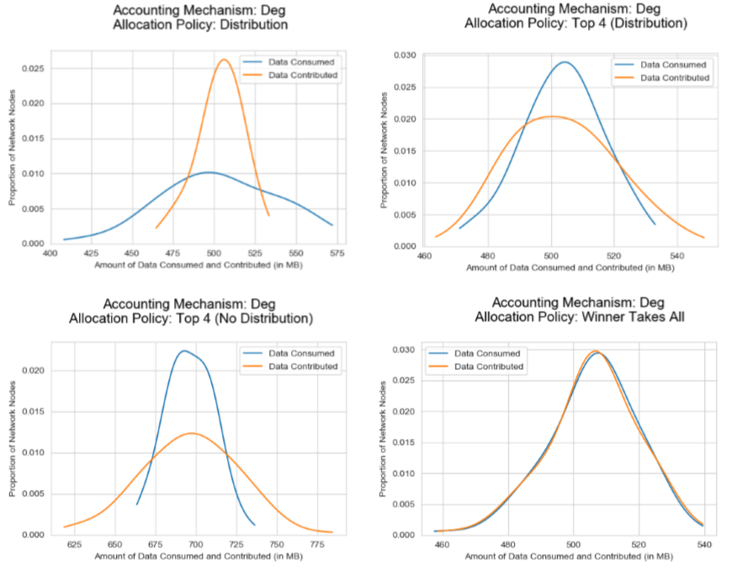

Slide 32

Sybil Attack Profit
${\left({G_{i}^{′}}^{\left(n\right)}\right)}_{n∈ℕ}$
$X_{ij}^{(n)}≔S_{i}^{M}({G′}_{i}^{\left(n\right)},j)$
${Y_{ij}^{′}}^{(n)}≔𝟙_{\{X_{ij}^{\left(n\right)}≥X_{ik}^{\left(n\right)} f.a k∈{C^{′}}_{i}^{(n)}\}}$
Problem: Cannot be determined!
Notes:
At this point we must assume an infinite model for the upper value to be finite in the case of a simple node creation

Slide 33

Redefining Sybil Attack Benefit
We still cannot determine in a generic setting
Idea: Redefine the cost and profit of a sybil attack in terms of accounting values, which are a proxy for the amount of work agents in the network are entitled to.

Slide 34
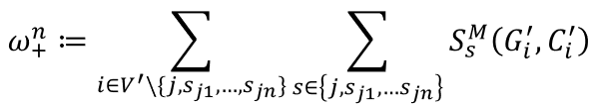
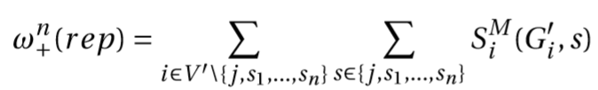
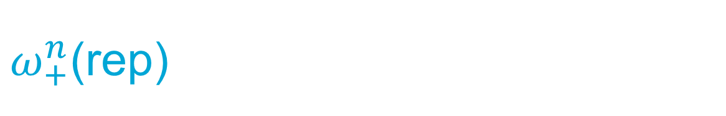
$ω_{+}^{n}$(rep)
Defining the profit is easy
How do we capture the amount of work the sybil attackers have performed for the network in terms of accounting values?

Slide 35
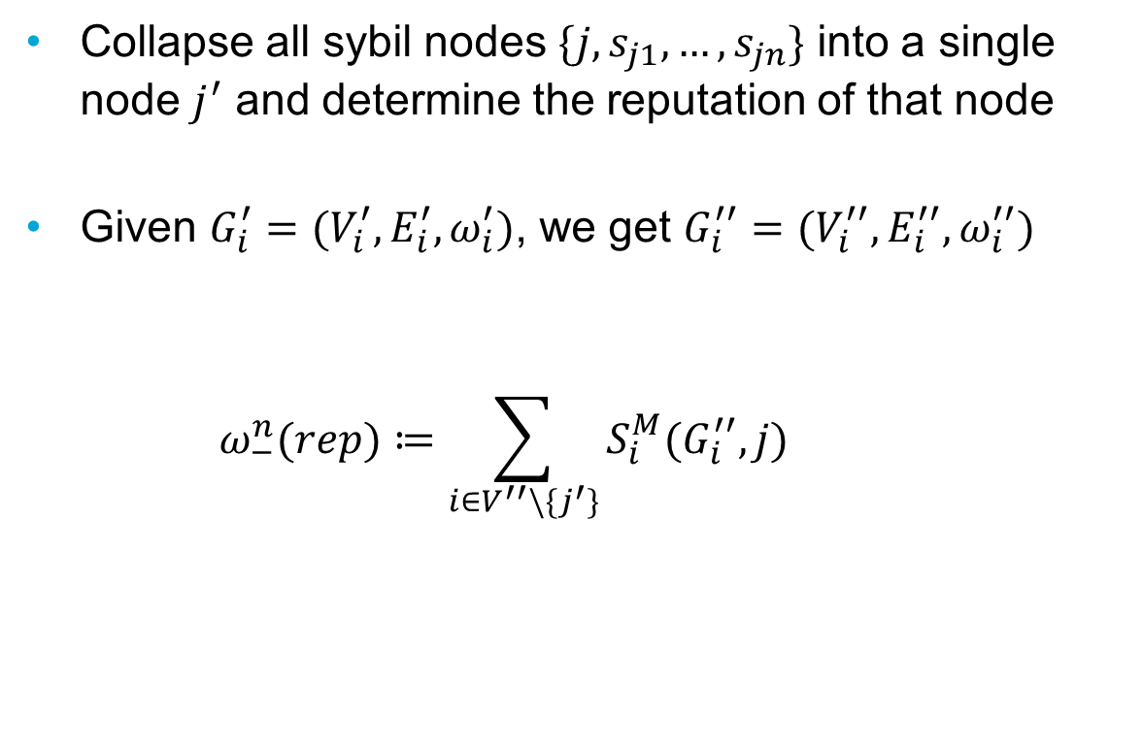

$ω_{−}^{n}$(rep)
Collapse all sybil nodes $\{j,s_{j1},…,s_{jn}\}$ into a single node $j^{′}$ and determine the reputation of that node
Given $G_{i}^{′}=(V_{i}^{′},E_{i}^{′},ω_{i}^{′})$, we get $G_{i}^{′′}=(V_{i}^{′′},E_{i}^{′′},ω_{i}^{′′})$
$$ω_{−}^{n}(rep)≔\sum_{i∈V^{′′}\backslash \{j^{′}\}}{S_{i}^{M}(G_{i}^{′′},j)}$$

Slide 36
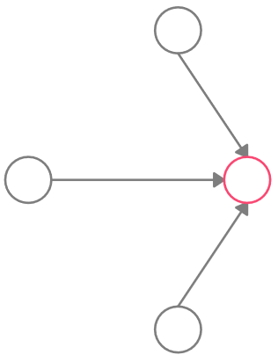
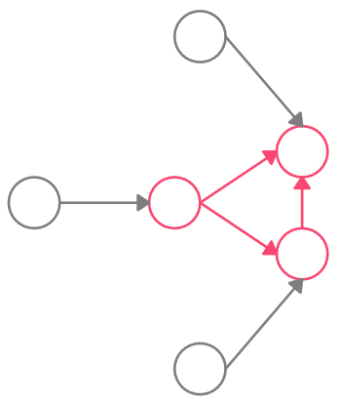






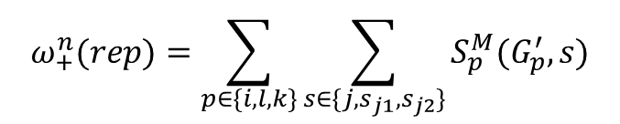





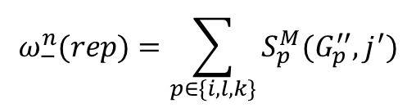


$$G_{i}^{′}$$
$$G_{i}^{′′}$$
$$k$$
$$k$$
$$s_{j1}$$
$$i$$
$$j$$
$$⟹$$
$$i$$
$$j$$
$$s_{j2}$$
$$l$$
$$l$$
$$ω_{+}^{n}(rep)=\sum_{p∈\{i,l,k\}}{\sum_{s∈\{j,s_{j1},s_{j2}\}}{S_{p}^{M}(G_{p}^{′},s)}}$$
$$ω_{−}^{n}(rep)=\sum_{p∈\{i,l,k\}}{S_{p}^{M}(G_{p}^{′′},j^{′})}$$

Slide 37
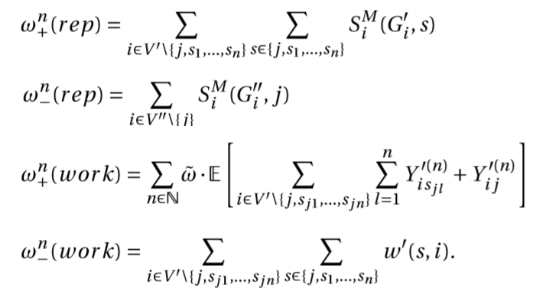
Recap of Cost & Profit

Slide 38
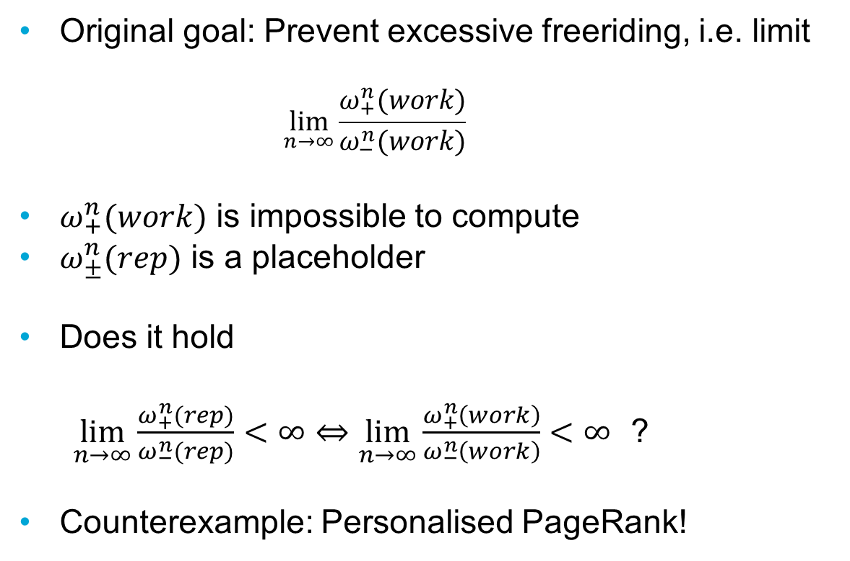
Question
Original goal: Prevent excessive freeriding, i.e. limit
$$\lim_{n→∞}\frac{ω_{+}^{n}(work)}{ω_{−}^{n}(work)}$$
$ω_{+}^{n}(work)$ is impossible to compute
$ω_{±}^{n}(rep)$ is a placeholder
Does it hold
$\lim_{n→∞}\frac{ω_{+}^{n}(rep)}{ω_{−}^{n}(rep)}<∞⇔\lim_{n→∞}\frac{ω_{+}^{n}\left(work\right)}{ω_{−}^{n}\left(work\right)}<∞$ ?
Counterexample: Personalised PageRank!

Slide 39
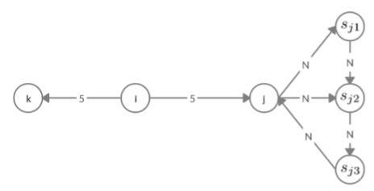

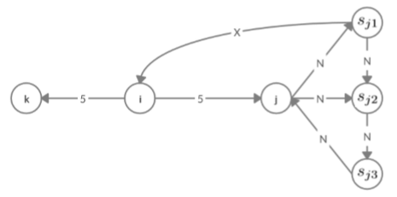
Counterexample PageRank
Accounting Values stay finite, but the amount of work the attackers can consume is infinite.

Slide 40
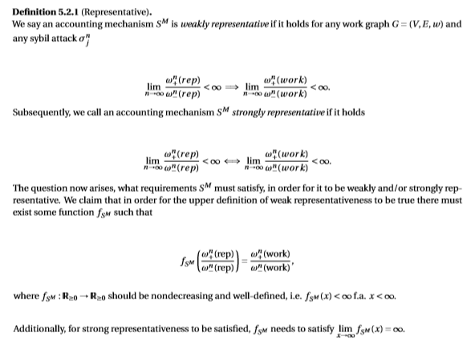

Representativeness of Accounting Mechanisms
$\frac{ω_{+}^{n}(work)}{ω_{−}^{n}(work)}$ and $\frac{ω_{+}^{n}(rep)}{ω_{−}^{n}(rep)}$ are not equivalent !
→ Representativeness

Slide 41
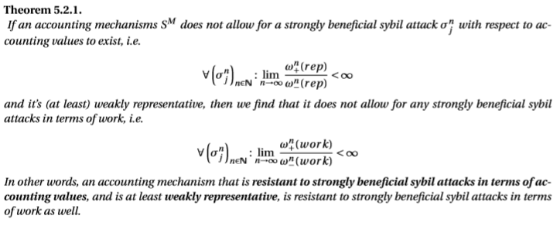
Theorem

Slide 42
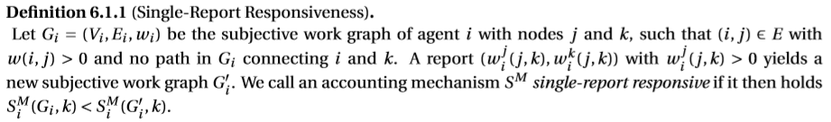
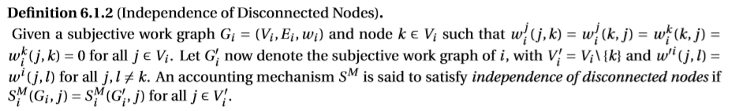
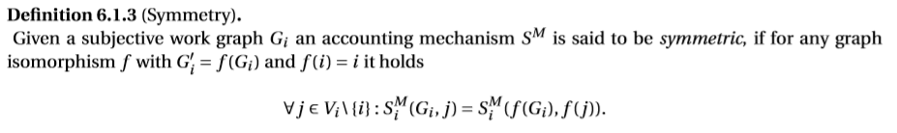
Seuken & Parkes Impossibility Result
[3]
2. Seuken, Sven, and David C. Parkes. "On the Sybil-proofness of accounting mechanisms." (2011).

Slide 43
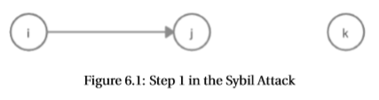


Seuken & Parkes Impossibility Result

Slide 44



We disagree with this result
1. Reason:
2. Reason:
At most weakly beneficial!
Really just proof of benefit in terms of accounting values, as allocation policy was not specified!

Slide 45

Improving Impossibility Results
Upper assertion is not yet disproven!
We can fix the proof!
Attacker can create additional sybil identities $s_{j1},s_{j2},s_{j3},…$
Single-report reponsiveness and independence of disconnected nodes will imply $S_{i}^{M}\left(G_{i},s_{jk}\right)>0$ f.a. $k∈ℕ$
Symmetry implies:
$S_{i}^{M}\left(G_{i},s_{jk}\right)=S_{i}^{M}\left(G_{i},s_{jl}\right)$ if $w\left(j,s_{jk}\right)=w\left(j,s_{jl}\right)$

Slide 46

Parallel-report Responsiveness
We require one additional property

Slide 47




Parallel-report Responsiveness

Slide 48


Weak Parallel-report Responsiveness

Slide 49




Extension of Results
Extend model to multiple hops
Extend model to active attacks

Slide 50





Serial-Report Responsiveness

Slide 51


Weak Serial-Report Responsiveness

Slide 52


Sybil-Proofness of Accounting Mechanisms
Invert results from previous chapter!

Slide 53


Resistance to Parallel Attacks

Slide 54


Resistance to Serial Attacks

Slide 55




Pyramid Sybil Attack

Slide 56



How can we upperbound generic sybil attacks by pyramid attacks?

Slide 57







Multiple-Path Response Bound
$$S_{i}^{M}\left(G_{i},j\right)≤S_{i}^{M}\left(G_{i}^{′},j1\right)+S_{i}^{M}\left(G_{i}^{′},j2\right)$$
$$S_{i}^{M}\left(G_{i},j\right)≤S_{i}^{M}\left(G_{i}^{′},j1\right)+S_{i}^{M}\left(G_{i}^{′},j2\right)+S_{i}^{M}(G_{i}^{′},j3)$$
$$S_{i}^{M}\left(G_{i},q\right)≤\sum_{n∈ℕ}{S_{i}^{M}(G_{i}^{′},qn)}$$

Slide 58
Proposition
Every Sybil Attack that is connected to honest node i by one path returns a profit that is bounded from above by the profit of a pyramid sybil attack
Every Pyramid Sybil Attack that is directly connected to node i returns a finite profit
Every Sybil attack that returns a positive profit must have cost greater zero
(path-responsiveness)
Every passive Sybil attack that is directly connected to i by a single path cannot be strongly beneficial!

Slide 59


Final Theorem
Add (bounded) transitive trust

Slide 60



Example
Personalised Hitting Time
Problem! Not weakly representative!
Solution:

Slide 61
Conclusion
Mathematical Framework for Accounting Mechanisms
Determined Sybil Attack Cost & Profit (in terms of accounting values and work)
Representativeness
Critical examination of existing results and expansion of these
Requirements for Sybil-Resistance

Slide 62
Conclusion
Research Question:
What requirements does an accounting mechanism need to satisfy in order to effectively incentivise cooperation and prevent lazy freeriding, while being resistant to misreport attacks and mitigating the effects of sybil attacks?

Slide 63
Appendix

Slide 64

Lazy Freeriding
Definition. For arbitrary, but fixed c:
Positive-report responsiveness + banning policy prevents lazy freeriding

Slide 65



Misreports
Definition
Misreport-attack on the subjective work graph
Misreport-Proofness on the choice set:
Drop-Edge

Slide 66



Misreports
Drop-Edge
Only achieves misreport-proofness on the choice set and only against misreports on the subjective work graph
(General) Misreport-Proofness:

Slide 67

Misreports
TrustChain: enhances the transaction structure
Transactions
Transaction sequences
Transaction functions
Transaction sets

